Slide 1
A Presentation On
Air Quality Monitoring System
GUIDED BY:-
MR. DEEPAK NARANG
By:
UTKARSH GAUR
VIKAS GUPTA
PRAVEEN KUMAR YADAV

Slide 2
CONTENTS
Introduction.
Air Quality Index(AQI)
Aims and Objectives.
Problem Statement.
Proposed Block Diagram.
Principle of Working.
Flow Chart.
Results
Advantages.
Limitations.
Applications.
Future Scope.

Slide 3
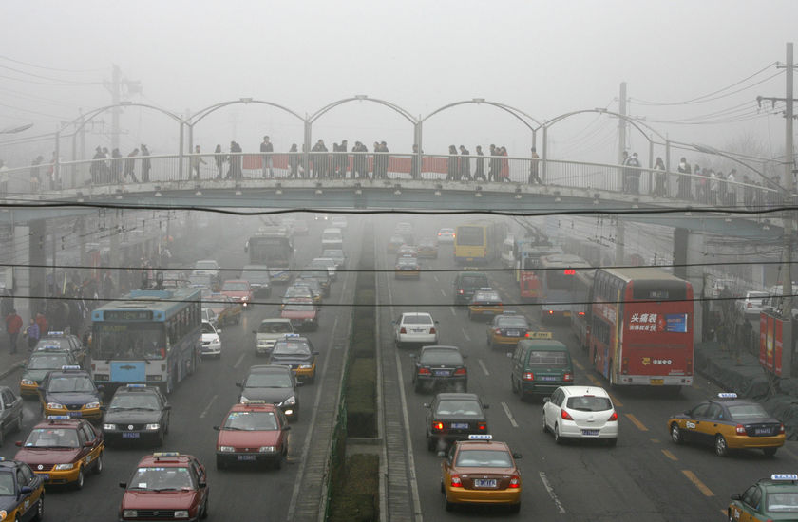
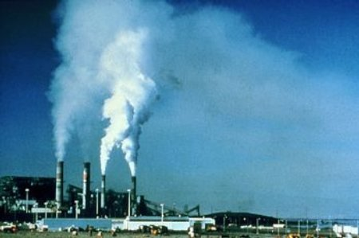
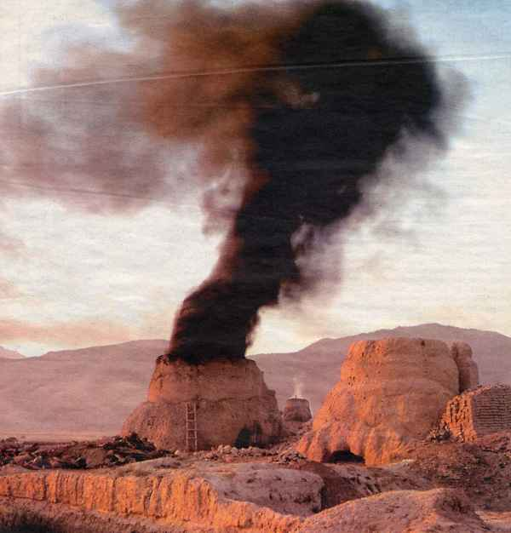
INTRODUCTION
Pollution
Traffic
Industries
Increase in vehicles
Health Problems

Slide 4
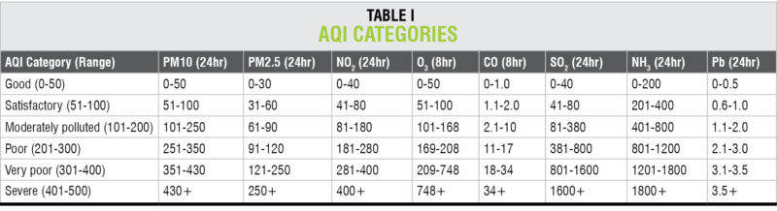
AIR QUALITY INDEX
Air Quality Index, or AQI, is a number used by government agencies to communicate to the public how polluted the air currently is, or how polluted it is likely to become. As AQI increases, an increasingly large percentage of the population experiences severe adverse health effects.

Slide 5
AIM AND OBJECCTIVES
To create a tool which will monitor the quality of air of our environment.
Sense the content of different gases present in air or area around us.(MQ-135)
Sense the temperature, humidity(DHT-11) and pressure (BMP180)of air.
Keep the date and time(real time clock).
Display the data on LCD(16x2).

Slide 6
PROBLEM STATEMENT
Design a tool which will-
1)Sense quality of air and display it in the form of percentage.
2)Sense the presence of benzene , alcohol and smoke(Carbon Mono-oxide) in air and display on LCD.
3)Sense the temperature & humidity and display it on LCD.
4)Sense the pressure of air and display on LCD.

Slide 7
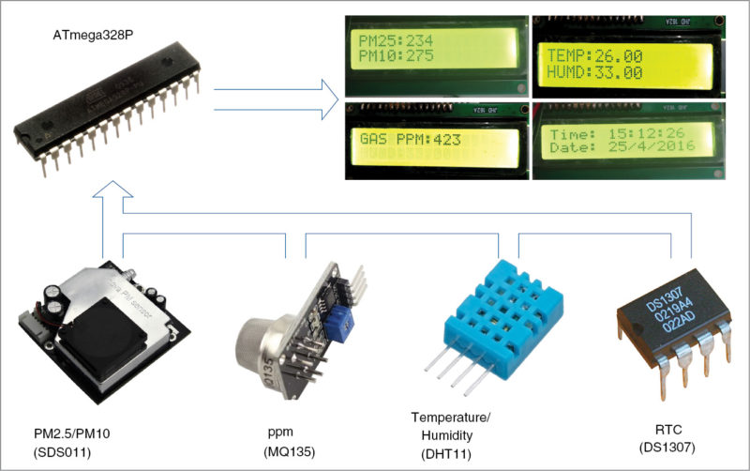
PROPOSED BLOCK DIAGRAM

Slide 8
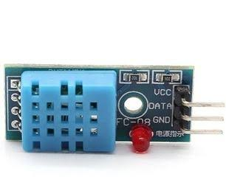
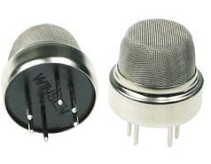
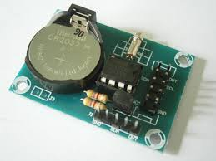
PRINCIPLE OF WORKING
Project’s basic principle of working is the sensing of data from the sensor .
Convert the analog ( voltage ) data into digital form.
Process the proportional digital data and display it on LCD.
Gas sensor directly display the digital data (HIGH /LOW)
MQ 135
DHT-11
Ds-1307

Slide 9
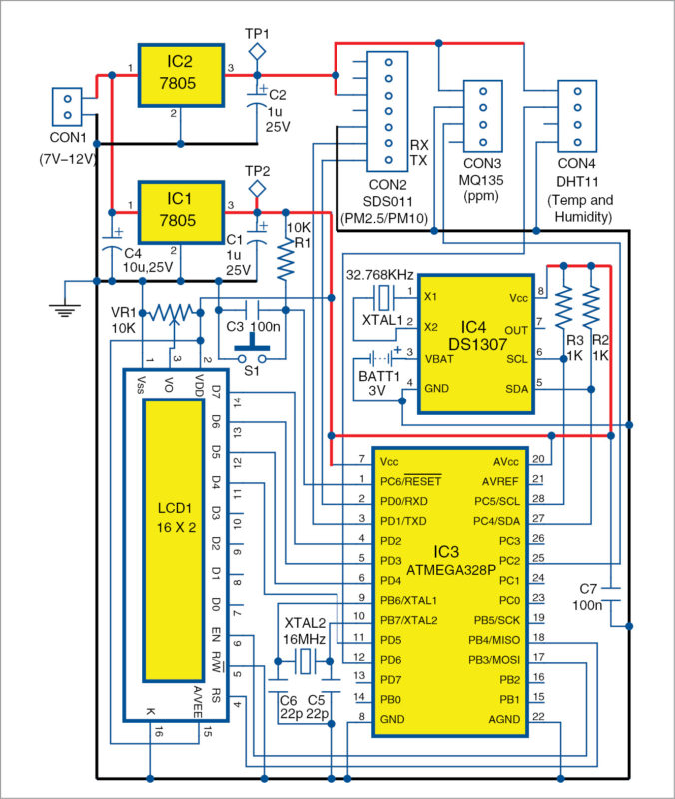
CIRCUIT DIAGRAM

Slide 10
COMPONENTS USED
ATmega328P:- It can be programmed with embedded software using a standard programmer or Arduino IDE. ATmega328P offers 23 input/output functional ports, and a 16MHz crystal oscillator is used to provide timing/clock reference.
Temperature and humidity module (DHT11):-This composite sensor contains a calibrated digital signal output of temperature and humidity.
Serial real-time clock (RTC) IC (DS1307):- It is a low-power, full binary-coded decimal (BCD) clock/calendar with 56 bytes of NV SRAM.
Air-quality sensor (MQ135):- The sensitive material of the sensor is tin-dioxide (SnO2), whose conductivity increases with concentration of gas. Change in conductivity is converted into output voltage signal, which varies corresponding to the concentration of the combustible gas.

Slide 11
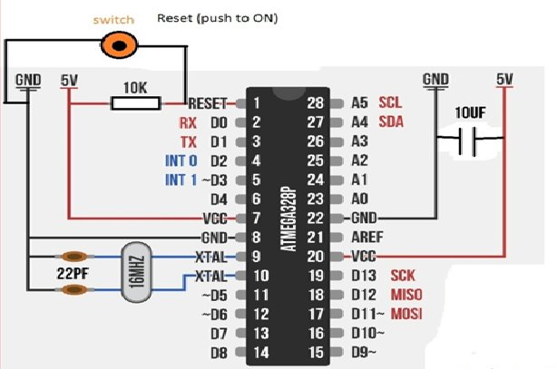
PIN DIAGRAM OF ATMEGA-328P

Slide 12
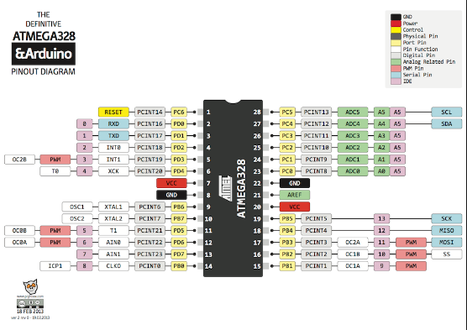
Pin connection of ATmega328P

Slide 13
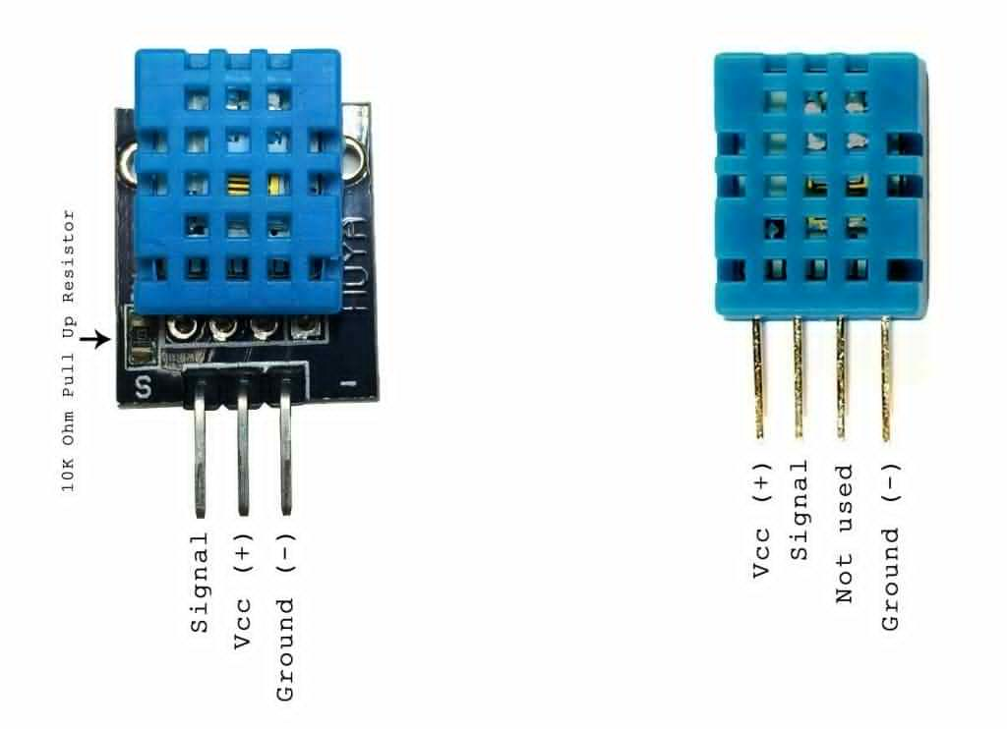
Temperature and humidity sensor (DHT-11)

Slide 14
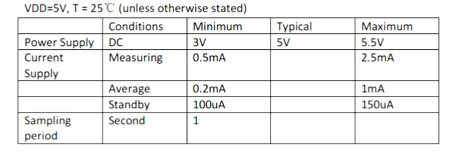
RATINGS OF DHT-11

Slide 15
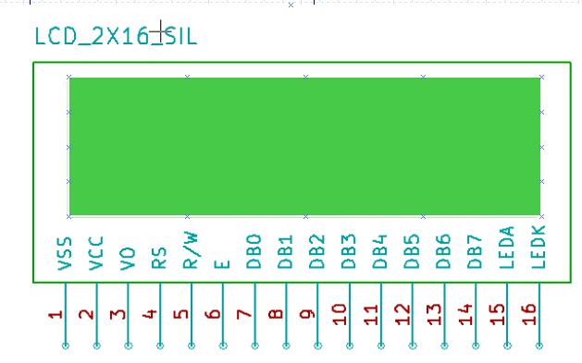
Pin diagram of LCD(16x2)

Slide 16
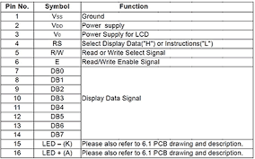
Connection of LCD

Slide 17
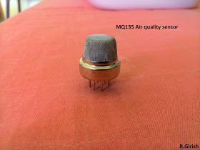
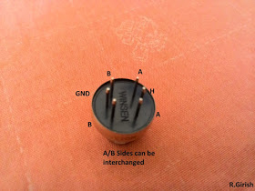
MQ -135 GAS SENSOR

Slide 18
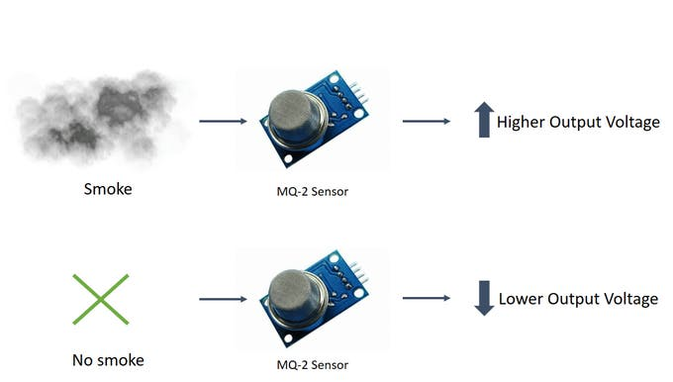
WORKING OF MQ-135

Slide 19
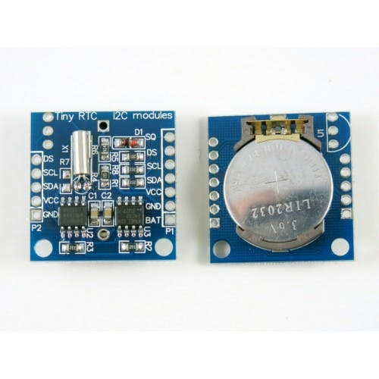
Real time clock

Slide 20
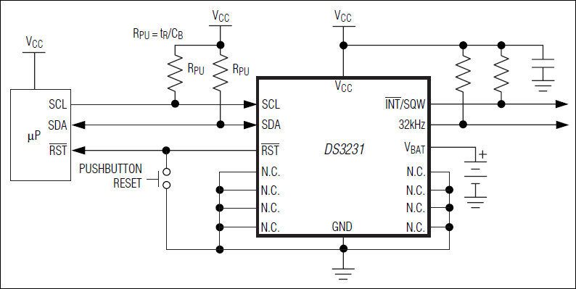
Connection of RTC

Slide 21
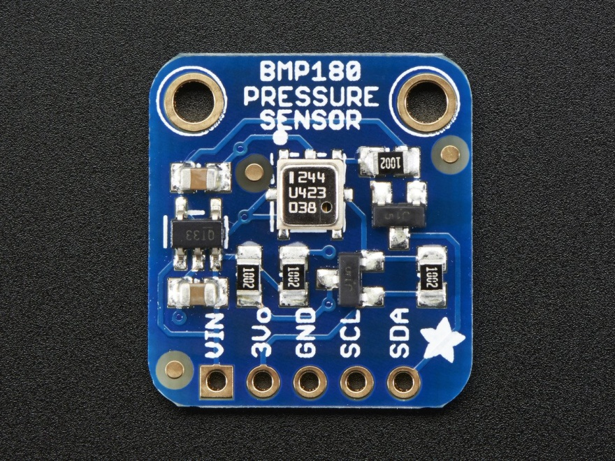
Pressure sensor(BMP180)

Slide 22
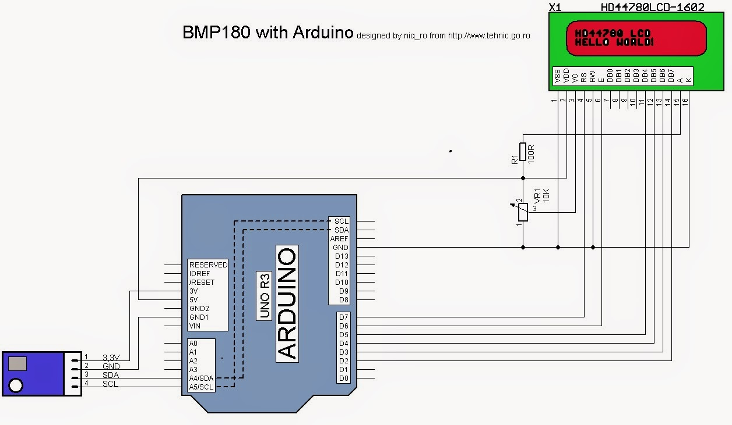
CONNECTIONS OF BMP180

Slide 23
RESULTS

Slide 25
ADVANTAGES
Sensors are easily available .
Detecting a wide range of gases, including NH3, NOx, alcohol, benzene, smoke and CO2,Co etc.
Simple, compact & Easy to handle .
Sensors have long life time & less cost.
Simple Drive circuit.
System is Real time.
Operating voltage : 5 volt,-20°C to +50°C
Quality of air can be checked indoor as well as outdoor.
Visual output.
Continuous update of change in percentage of quality.

Slide 26
LIMITATIONS
Only 3 sensors are used.
Humidity should be less than 95%.
Accurate measure of contaminating gases cannot be detected in ppm.

Slide 27
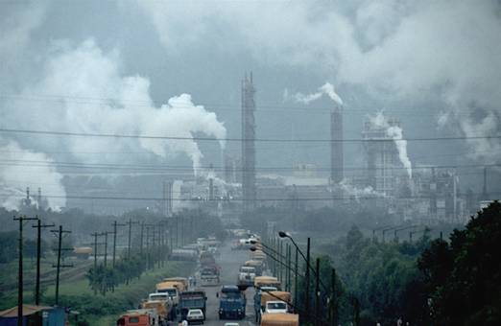
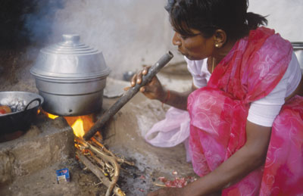
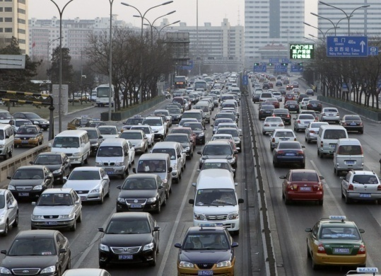

APPLICATIONS
Roadside pollution Monitoring .
Industrial Perimeter Monitoring.
Site selection for reference monitoring stations.
Indoor Air Quality Monitoring.
To make this data available to the common man.

Slide 28
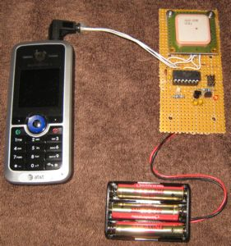
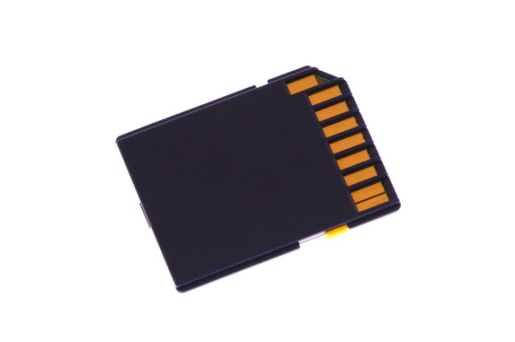

FUTURE SCOPE
In future the project can be upgraded in more ways than one.
Interface more number of sensors to know detail content of all gases present in air.
Design Webpage and upload data on webpage with date and time.
Interface SD Card to store data.
Interface GPS module to monitor the pollution at exact location and upload on the webpage for the netizens.

Slide 29
Thank You

